Slide 1
超越学科界限的认知基础 Transdisciplinary Cognitive Foundation Week 10 Artificial Intelligence and its Social Impacts
Ben Koo
November 16, 2020

Slide 2
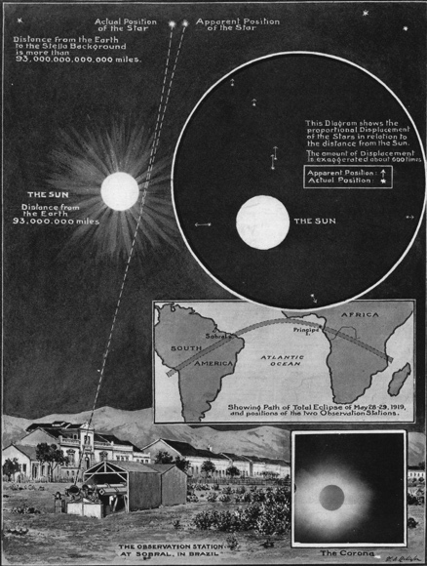
Context
Having discussed Smart City applications
An ideal application of Cybernetics
Scale sensitive application
A way to reflect collective consciousness
Lead into our discussion today, on AI and its social impacts.
Identify a desired scope of your cognitive actions ...
Image source:
Ask Ethan: Is Spacetime Really A Fabric?

Slide 3
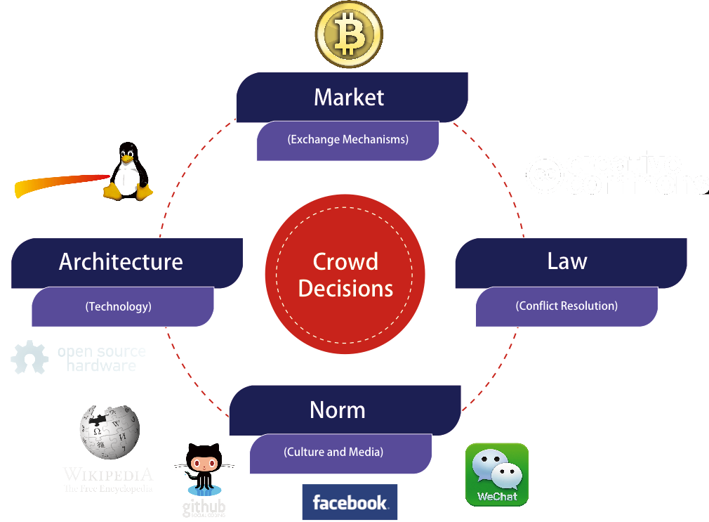
Spacetime Representations for a Collective Conscious
FAR
Space
NEAR
BEFORE Time AFTER

Slide 4

The Master Algorithm that will rule the world?
Bill Gates recommended this book
in 2016 Code Conference
The thesis:
Processing data through a single universal learning algorithm— can get all the knowledge from the past, the present, and the future
Pedro Domingos, TMA, P. 25
Chinese Translation
4

Slide 5
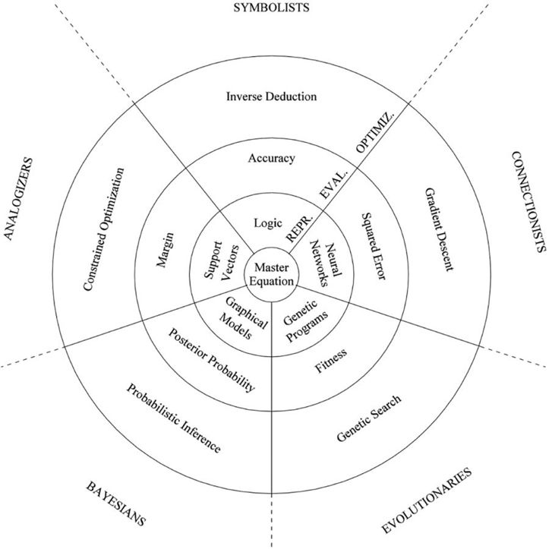
The Master Algorithm with Five Elements
Image Source: P. 240 of The Master Algorithm
5

Slide 6
The Allegory of the Master Algorithm
（寓言）
The Allegory of a Smart City made of 3 concentric circles and occupied by 5 tribes:
Circles:
Optimization (Search)
Evaluation (Assessment and Rewrite)
Representation (NsM)
Practical Concerns:
Optimization (Search)
Scalability
Evaluation (Assessment and Rewrite)
Correctness
Representation (NsM)
Sound/Complete
Master
Equation
Chinese Translation
Image Source: P. 240 of The Master Algorithm
6

Slide 7


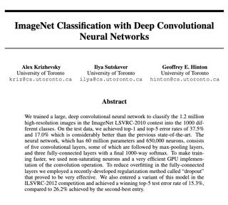
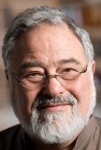
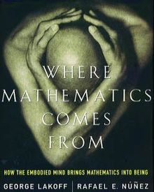




The Leaders of the Five Tribes
Image Source: P. 240 of The Master Algorithm
7

Slide 8

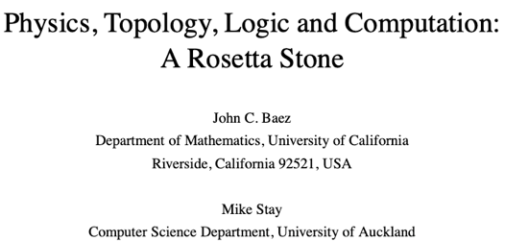
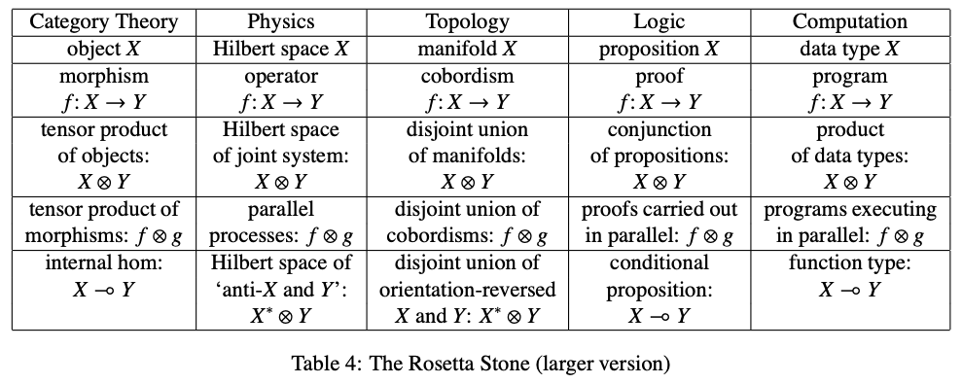
The Rosetta Stone by John Baez
Image source: wikipedia

Slide 9
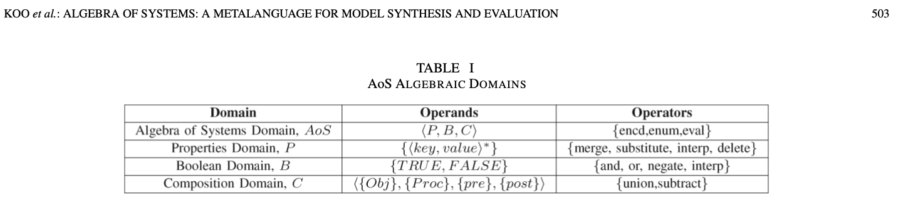
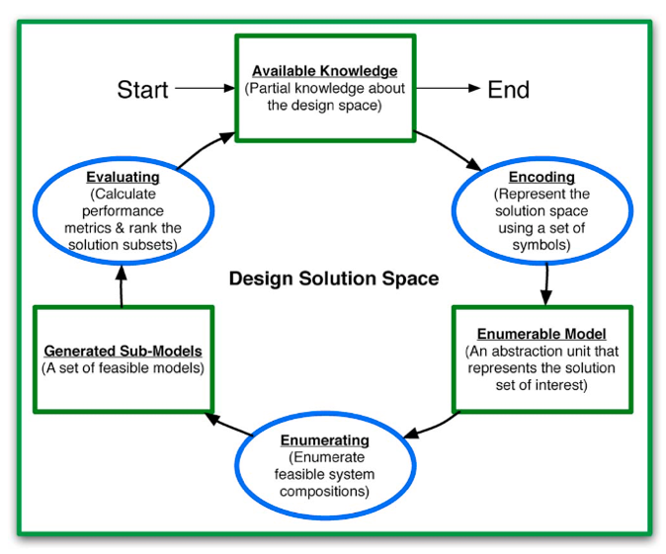
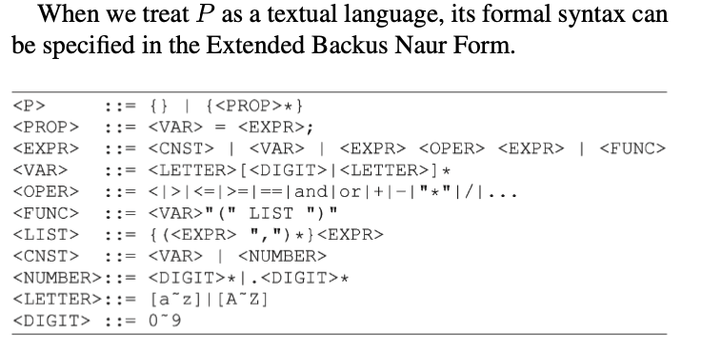
Computable Multi-level Abstractions

Slide 10
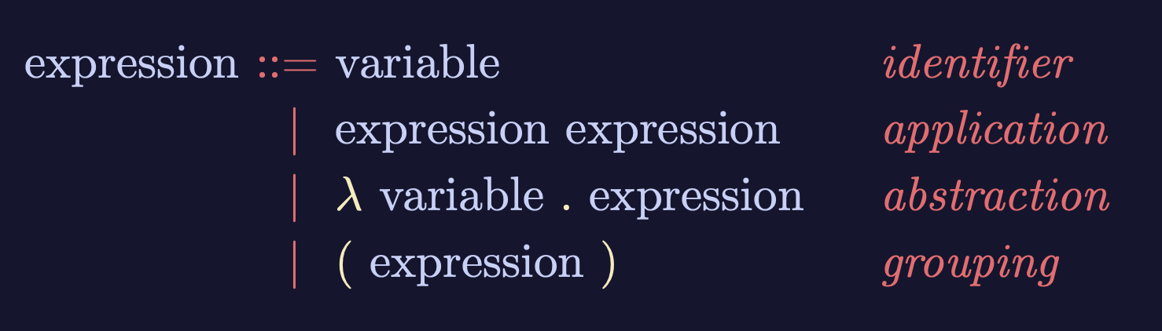


Lambda-Calculus is an Ouroboros
Variable
Expression1
Expression2
𝜆
Variable
Expression
( )
Expression
Lambda calculus as an executable rewrite process is a Lattice/Poset.
Paradigm shifting concepts
and
incommensurable terms
Normal Science
Model
Drift
Model Crisis
Model Revolution
Paradigm
Change
Learning as a vocabulary acquisition process!
Early alchemical ouroboros illustration with the words ἓν τὸ πᾶν ("The All is One") from the work of Cleopatra the Alchemist in MS Marciana gr. Z. 299. (10th Century)
Image and Text: Wikipedia
Backus-Naur Form provides a way to customize the “concrete syntax” of formal languages.

Slide 11
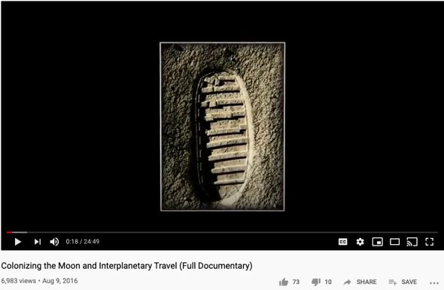
Goal
Stating objectives in scope
Use imperative sentence to express intent. Be active!
Draw on forces that are present in the context, align your argument with contextualized information
Preparing a proposition that has concrete and verifiable outcomes
For example: Colonizing human in space…
Identify a desired scope of your cognitive actions ...
Image sources:
Ask Ethan: Is Spacetime Really A Fabric?

Slide 12

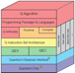











An integrated (ethical) architecture
to implement the Master Algorithm
Software
Hardware
Scientific “Evolution”
Neutral Network
Symbolic Logic
Causal Probability
Conceptual Analogies
T. Kuhn
Content
IoT and Quantum Computing
TPU
GPU
CPU
Big Data
Computed Data
Artificial Data
Resource
Standard
J. Hinton
Distributed
Centralized
General Protocol
S. Wolfram
J. Pearl
Governance Strategies
Collective learning systems
Data Assets, Structures
Extreme Learning Process
G. Lakoff
Computing Architectures, Instrumentation
Encoding strategy, Ontology, Epistemology

Slide 13
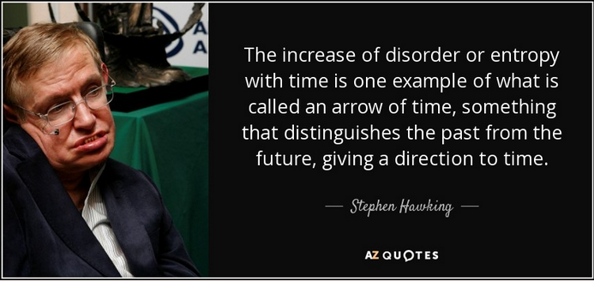
Success Criteria
A set of conditional statements that qualifies the success criteria to achieve the stated goal(s)
Conditional statements that can be judged to yes/no results
Certain success criteria can be measured in terms of degree of success (portions accomplished)
Success measures maybe assessed in terms of Time and Entropy (probability of success) values.

Slide 14
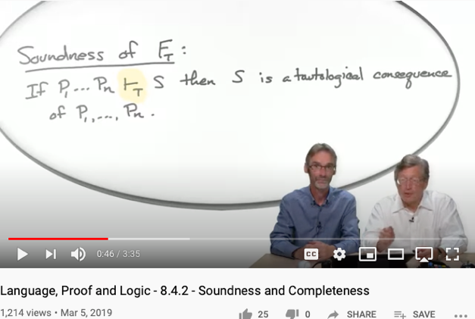
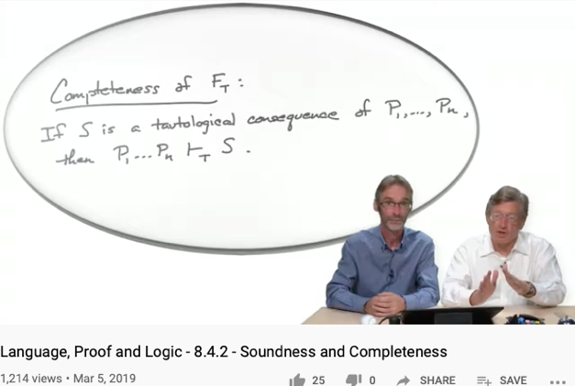
Soundness
Completeness
Every provable statement is true
Every true statement is provable
Cited from : Soundness and Completeness: With Precision on news.ycombinator.com
https://youtu.be/3hspKYIn5ds?t=29
https://youtu.be/3hspKYIn5ds?t=162

Slide 15
The Expanded Capability of “Search”
and how AI relates to them
Capability | AI inspired threats | Solution to AI threats
Search | Digesting overwhelming amount of knowledge | Apply search to private knowledge
Optimize | Solve problems assumed to be impossible | Become aware when impossible become possible
Simulate | Offer future plans at rates much higher than traditional wisdom | Update inadequate possibility model of our surroundings

Slide 16

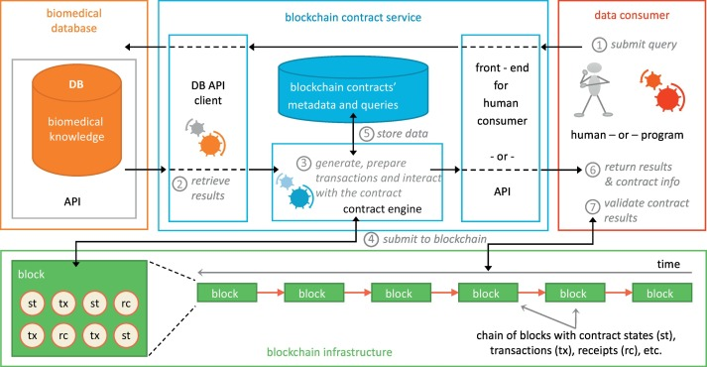
Output
Deliverables at the end of Project
A list of deliverables that are encoded in a generally acceptable namespace
Define outputs in precise technical terms, using a scalable namespace management tool, such as MediaWiki
Output content should be marked with time and contributors’ non-repudiable signatures
Image Source: A Blockchain-Based Notarization Service for Biomedical Knowledge Retrieval
https://www.sciencedirect.com/science/article/pii/S2001037018300400

Slide 17


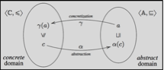
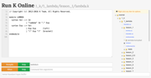

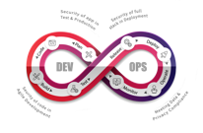
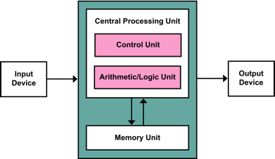
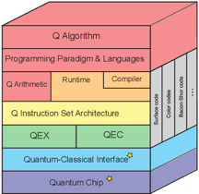






Computing Architectures associated with Tools
Abstract Specification
Concrete Implementation
Deterministic
Probabilistic
Centralized
Hybrid
Distributed
Single/Multi Core
Many Core
Single Site
Multi Site
Many Site
Hackerspaces
Super Computing Center
Notes:
17

Slide 18

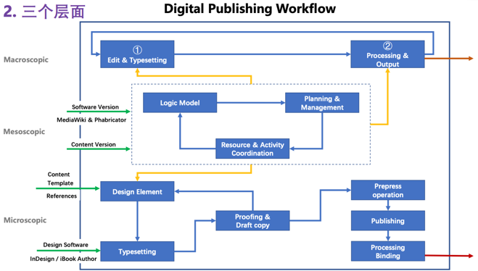
Organized Activities
A well-defined set of Actions and iterative Branching Strategies
A Roadmap of composable activities
Sequencing and timing conditions
Explicitly state dependencies and resource requirements

Slide 19
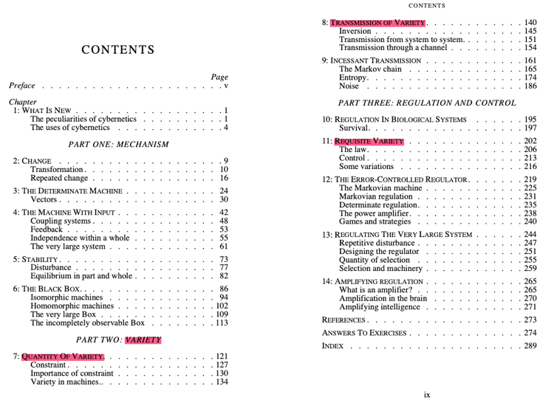
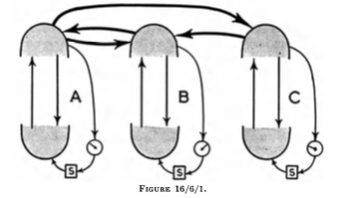
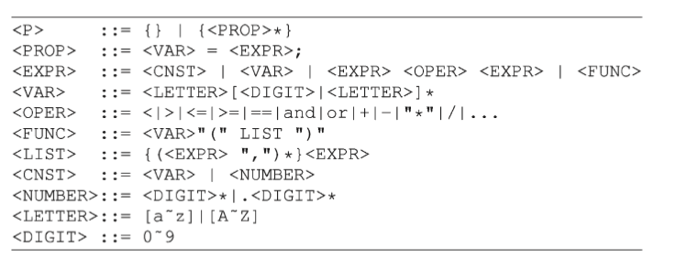
Cybernetics as Applied Category Theory
In Ross Ashby’s work, he presented Cybernetics as an abstract framework for representing a variety of formal rewrite systems.
Later Norbert Wiener also stated that Monad plays an important role in this Cybernetic. Which suggest that it needs a Universal Rewrite mechanism, like Lambda-Calculus, which is realized in Backus-Naur Form.
Image source: Design for a Brain by Ashby
Paradigm shifting concepts
and
incommensurable terms
Normal Science
Model
Drift
Model Crisis
Model Revolution
Paradigm
Change
Learning as a vocabulary acquisition process!
Early alchemical ouroboros illustration with the words ἓν τὸ πᾶν ("The All is One") from the work of Cleopatra the Alchemist in MS Marciana gr. Z. 299. (10th Century)
Image and Text: Wikipedia
Backus-Naur Form provides a way to customize the “concrete syntax” of formal languages.

Slide 20

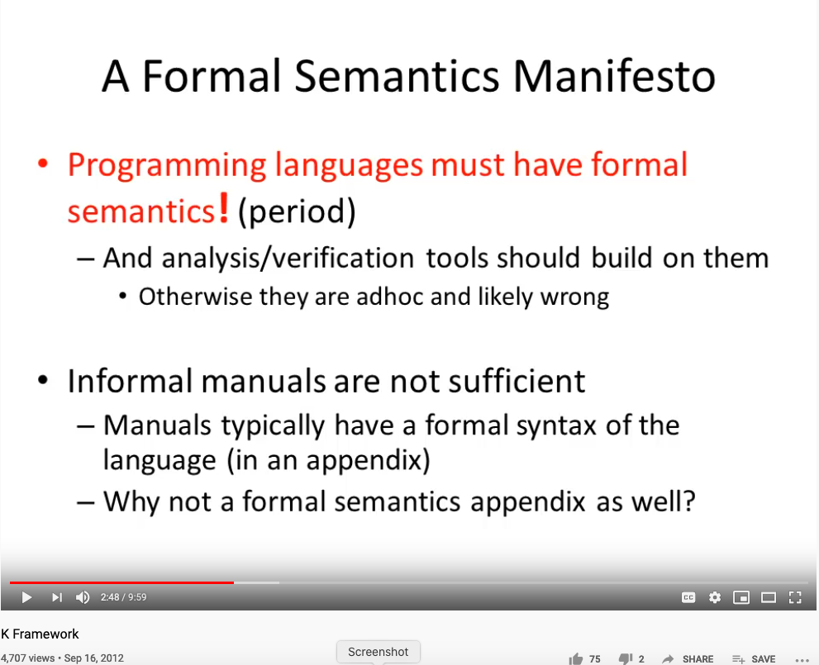
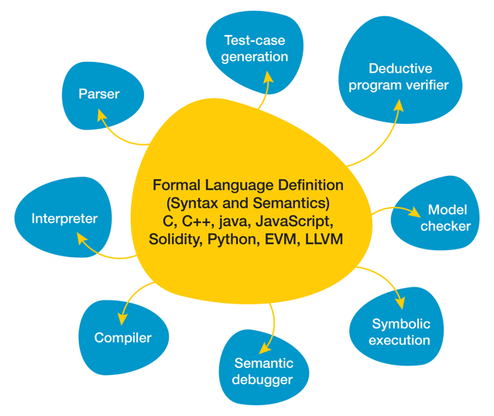
Reasoning about all Languages Rigorously?
Huawei VP Mr. Yang Shaoqing
The K Framework & Formal Verification Efforts in the Blockchain Space
By Ola Kohut
RICH 70 Tsinghua SEA Cloud Forum, Sep 14, 2020
H. E. Bambang Brodjonegoro,
Minister of Research & Technology, Indonesia

Slide 21

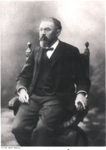

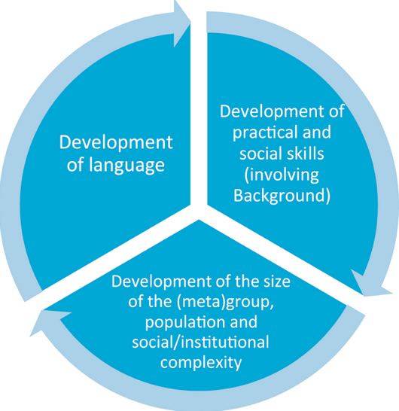
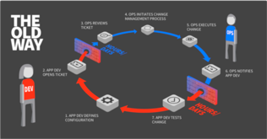



A linguistic approach to unify the cognizance across scales
Namespace = Cognitive Space

Slide 22
A Cognitive Learning Program that utilizes Contemporary Tools

Slide 23
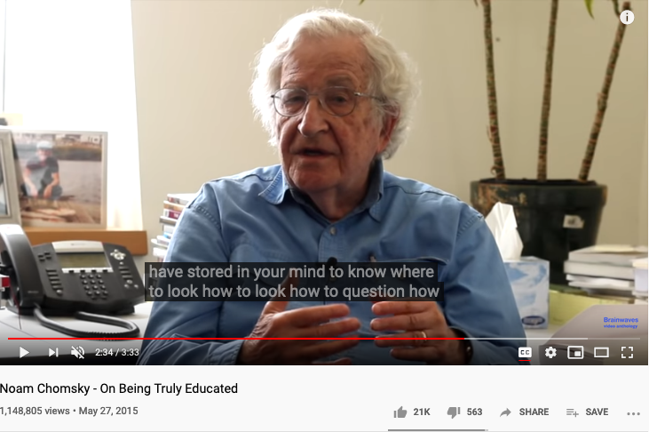
On Being Truly Educated
Prof. Noam Chomsky: the founder of modern cognitive sciences.

Slide 24
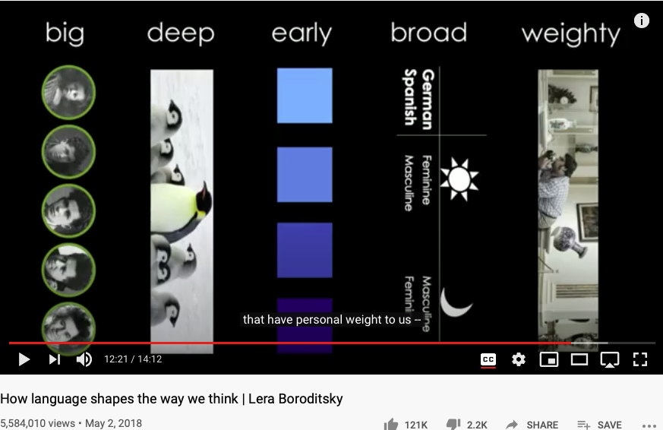
Language choices influence your Cognitive Foundation
Huawei VP Mr. Yang Shaoqing
https://youtu.be/RKK7wGAYP6k

Slide 25
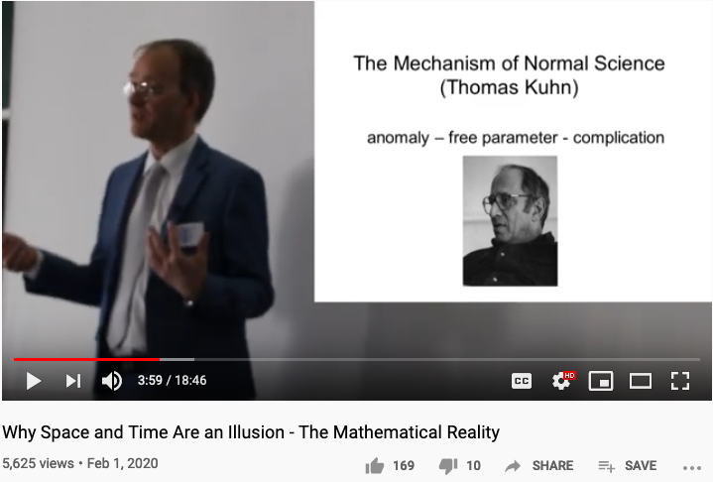
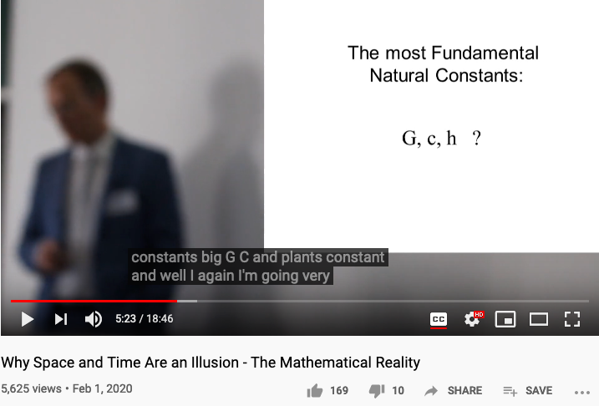
Reserved Names and Constants in Sciences
Unzicker’s Observations:
Revolutions in physics have always eliminated arbitrary numbers
A complete theory of reality must do without any constants of nature
https://youtu.be/zxAV_Re4OWA?t=239
https://youtu.be/zxAV_Re4OWA?t=323
On the origin of constants C and h, by Alexander Unzicker, last accessed Oct 20, 2020

Slide 26
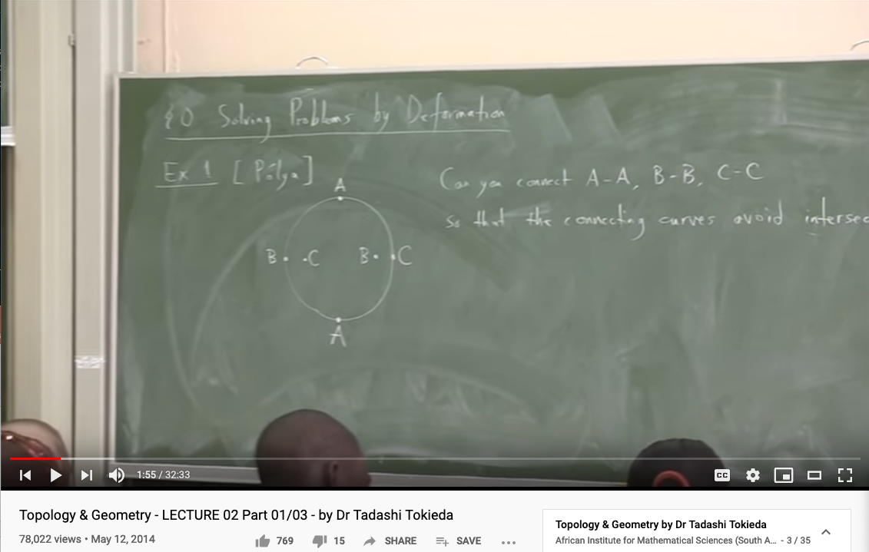
Knowledge Representation in Topology (the trick of converting a problem to a simple domain and back)
Youtube Link: https://youtu.be/8YDw4YxT-FM?t=398

Slide 27
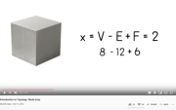
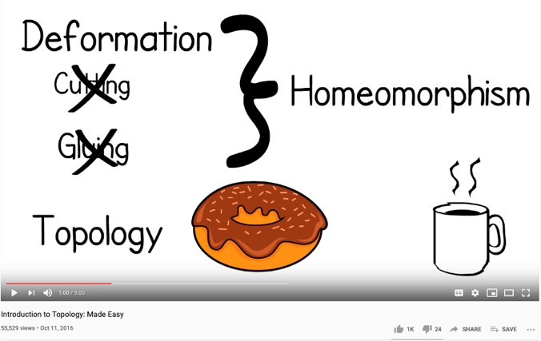
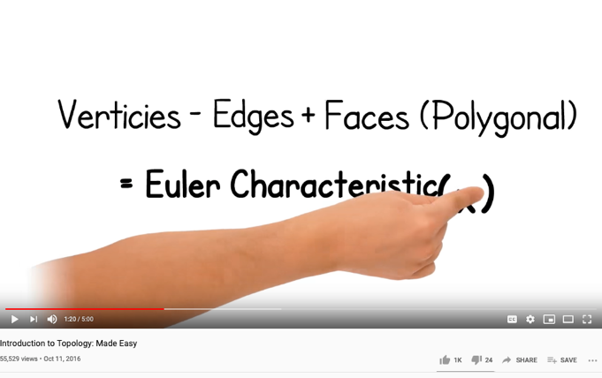
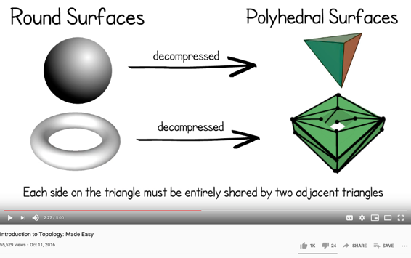
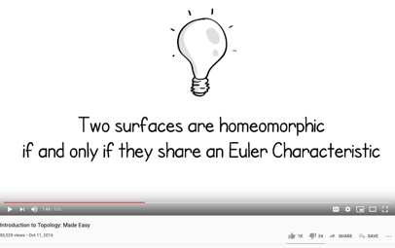
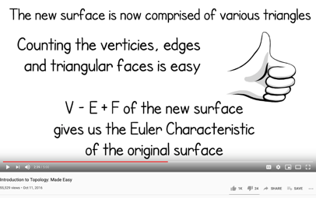
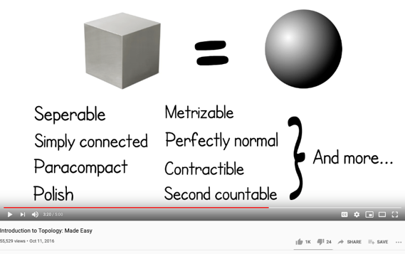
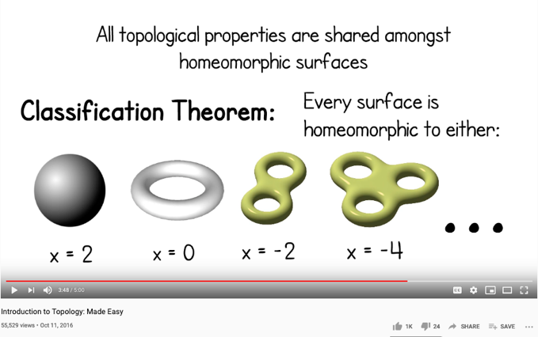
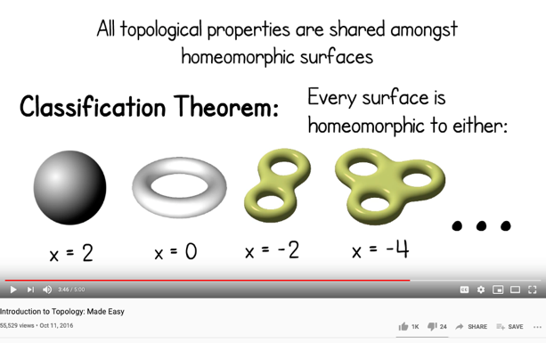
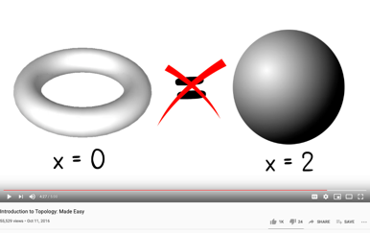
Homeomorphisms as a way to establish Equivalence
Image and Text Source: https://youtu.be/VOKgMJEc_ro

Slide 28
Computationally-Enhanced Cognitive Foundation Transcending the Boundaries of Human, Machines, and Knowledge Disciplines
Huawei VP Mr. Yang Shaoqing

Slide 29
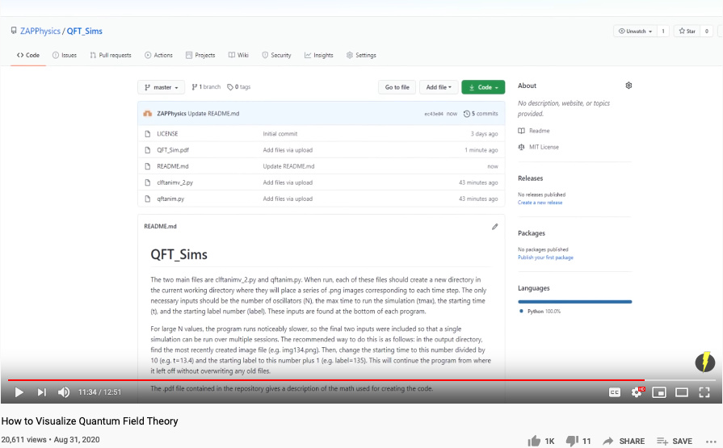
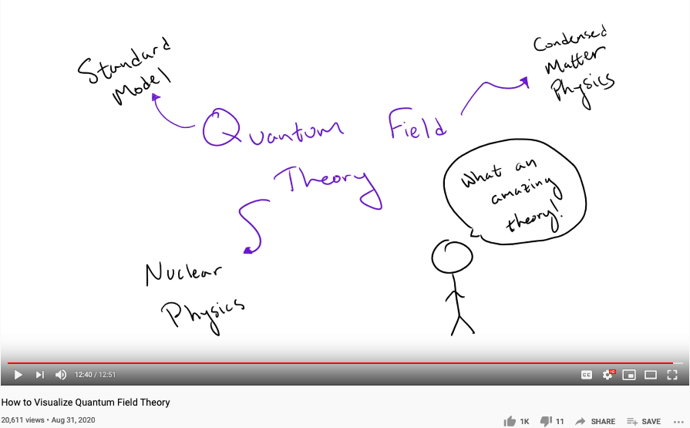
QFT: The Most Successful Theory So Far
Youtube Channel: ZAP Physics

Slide 30
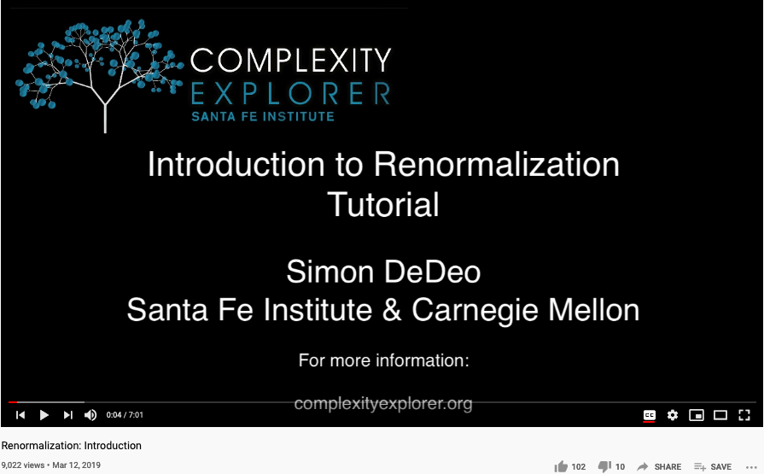
A Series on Renormalization Theory
Youtube Channel: Complexity Explorer

Slide 31

The foundation of math as programming languages
Prof. Robert Harper

Slide 32

First and Second Order Cybernetics

Slide 33




Intervention and Counterfactual are Higher-order Functions

Slide 34



The expressive power of Names (labels)
Huawei VP Mr. Yang Shaoqing
Prof. George Lakoff

Slide 35



Input
The required resources to conduct your work
Existing theories, methodologies, and guiding principles
Tools and Data sources that can help reduce uncertainty
Detailed budget in terms of data assets, monetary terms, and supporting personnel
Methods
Tools
Applications

Slide 36


Context: Modern Technologies challenges the cognitive capacities of human and human societies.
Goal: Provide a methodical cognitive framework to leverage contemporary technologies and cognitive science content.
Success Criteria: Enable students to utilize cognitive methods and tools, while measuring learning outcomes accordingly.
Outputs
Cognitive Science Report
Summarize your methods
Digitally published Learning Reports
Behavioral Data (on MediaWiki)
Personally chosen application areas
Biology, Physics, Math, Literature, Social Science, Arts, …
Activated Processes
1. Course Preparation
Content and Process design
2. Learning Program Execution
16 week exercise
3. Program Refinement
Continuous Adjustments
Periodic Refinements
Inputs
Curricular Structure
Coherent with university-level curriculum design
Content Data
A time-oriented knowledge(data) representation framework
Meta Data Formats
Logic Model(OKRS), Learning Report Format, Universal Resource Locators
Boundary Conditions: Personal willingness to adopt a new cognitive foundation, and intensity of practicing this new skill

Slide 37





Inputs for Collective Cognizance
A domain-independent knowledge model (curriculum data) for
learning organizations with data collection tools and
statistical data analysis practices (namespace management)
Knowledge Content Data such as
Biology, Physics/Chemistry, Math/Computing
To be taught in ”schools”.
A consistent format to be shared by all content
publishers in the community.

Slide 38

Introduce Balanced Strategy Map (BSM) by Kristy Wong A new kind of Logic Model & a variant of OKRs (Spring 2020)

Slide 39



2018 International Summer Program @ Tsinghua Experience a publishing workflow using DevOps

Slide 40

Why is AI challenging the Status Quo?
INDUSTRIALIZED Communication and Control CHALLENGED THE BOUNDARY OF HUMAN COGNITIVE POWERS
THE SPEED OF CHANGES EXCEEDS MENTAL CAPACITY
Societal Implosion & Globalized Chaos
Incoherent minds and body
overwhelmed by new knowledge
lost of self-worth

Slide 41


Kuhn Cycle: as the ticking clock
Normal Science
Model
Drift
Model Crisis
Model Revolution
Paradigm
Change
Emerging cases or
systematic attacks
Product Development Process
in five stages
Commit
Build
Test
Stage
Deploy

Slide 42



Societal Clockspeed determines how People Think

Slide 43




Speed is the Dominant factor in Decision Making
A NEW Cognitive Foundation is needed to enable
Sufficiently FAST
collective learning!

Slide 44





The World has changed … Ways to conduct business have changed …
https://en.wikipedia.org/wiki/George_Hotz

Slide 45


Three Scales of Time
Mesoscopic：
Localized Adjustments
Time Stamp
Macroscopic:
Five Stages of Evolution
Normal Science
(commit)
Model
Drift
(build)
Model Crisis
(test)
Model Revolution
(stage)
Paradigm Change
(deploy)
Microscopic：
Process Data and Summative Result
Time Stamp

Slide 46
Time Stamped Data Preserve Event Ordering Information
Normal Science
(commit)
Model
Drift
(build)
Model Crisis
(test)
Model Revolution
(stage)
Paradigm Change
(deploy)
Time Stamp
Time Stamp
Time Stamp
Time Stamp

Slide 47

Blockchain, Distributed Ledger Technologies: uses Time-stsamp to create Trust-worthy Data
https://www.investopedia.com/terms/b/blockchain.asp

Slide 48






A Model of Collective Cognitive Processes
(students/teachers)
(Smart) Social Contract Execution
Traders
Miners
Coders
(Consumers/Distributors)
Three Asynchronous
Clocks in their respective
Communities
Version Upgrade
Production Code
Function Requests
Customer Crisis
Feature Revolution
Emerging cases or
systematic attacks
(Artists/Creative Projects)
(Administrators/Witnesses)
Perform Checking
receive confirmation
commit transaction
(Content Producers/Product Designers)
(Accountants/Lawyers)

Slide 49

Smart Contract with Observable Historical Data
ISDA: International Swaps and Derivatives Association

Slide 50



Legal Algorithms in Pentland’s new book a New Economy is coming …

Slide 51






A Proposed “AI” Orchestration Architecture
Decision for Data Asset Transaction
Library of
Linked Knowledge
(Data Plane)
Library of Executable Algorithms
(Control Plane)

Slide 52
What would your gain by taking this Course?

Slide 53
If you had been following this course…
Elevate Students’ Knowledge Orchestration Strategies up to the level of necessity presented by contemporary industrial complex
A foundational learning strategy that will continue to work as technologies progresses and complexity/entropy increases
Knowing the essence of data management under a dynamic context
Knowing how namespace management strategies and tools can be used to manage any projects (version control)

Slide 54
Conclusion
Artificial Intelligence (AI) is shaping a foundation of collective consciousness
Modern AI(both Artificial Intelligence and Abstract Interpretation) prescribed a “Master Algorithm” to computationally manipulate and verify abstract specifications
All data types and algorithms are encoded as Lattice/Posets, so that it can be enumerated and evaluated. (See Koo 2005 Ph.D. Thesis on Meta-Language for Model Synthesis)
Improved method to generate Abstract Specification accelerates concrete implementations
Communication and Control increased the density and accuracy of governance
Pearl’s Intervention and Counter-Factual made intent and alternatives representable
Cybernetics can be considered as an organizing principle for intent and alternatives
Globally time-stamped data is becoming a generic medium for Trust-worthiness verification
Time-stamped Data provides a Naming Convention to transform all Data Types into Lattice/Partially Ordered Set as a kind of Trust worthy and Universal Data Asset
Trust-worthy Data and Universally Applicable AI creates new societal orders

